Slide 1

The Problem with Credit Checks
How a common rental screening practice can devastate lives

Slide 2
What Wall Street and credit card companies are doing is really not much different from what gangsters and loan sharks do who make predatory loans. While the bankers wear three-piece suits and don't break the knee caps of those who can't pay back, they still are destroying people's lives.
- Bernie sanders

Slide 3
We are so used to Credit Checks as part of the rental screening process that we never stop to wonder if it should be part of the “standard.”
It is a huge problem that people’s ability to get housing can be directly related to their Credit Score.
Housing is a basic need and we allow landlords to affect our access to this BASIC NEED based on our ability to make unrelated payments; medical bills, student loans, automobile repairs, etc..
So many factors unrelated to rent payments can negatively affect someone’s credit score. It can damage a person with a perfect rent payment history.
This industry-standard of relying on credit scores to judge a person’s future behavior as a tenant ends up pushing many applicants into sub-standard housing, paying additional deposits, or forcing them to move out of the city and further away from economic opportunity.

Slide 4
“But I always pay my rent on time?!?”
Credit isn’t an accurate way to judge a consumer’s activity. Rental payments, cell phone payments and others are not included in calculations for credit scores. Most people, when going through hardship will pay their rent before they pay their other debts because they do not want to lose their housing. So even though a consumer is consistently paying rent on time, the fact that they let their Student Loans lapse could still cost them housing in the future.
Simply put: Credit scores by themselves typically are not based upon the applicant’s history of rent payment and do not necessarily predict the likelihood of paying rent on a regular and timely basis.
“Lacey Gonzalez, who lives in south Minneapolis, hopes the ordinance will give everyone “a fair opportunity” to find housing. She said that, for 10 years, landlords have turned her down most often because of her debt and low credit score. She always paid her rent on time but admits that she did not always make credit card payments.”
https://www.startribune.com/small-landlords-fear-limits-on-tenant-screening/560181422/

Slide 5
Why should we trust credit reporting agencies?
Credit Scores are not 100% representative of a consumer’s behavior. Look at the large credit breaches we have seen with Equifax, Experian and TransUnion. Those data breaches allowed the private financial information of millions of American’s to be shared with strangers. Identity Theft can ruin a consumers Credit Score and not be caught until irreparable damage is done.
It’s is frightening how many credit breaches there have been in the last decade! These breaches leave consumers open to Identity Theft and can ruin their credit score for years to come.

Slide 6
Just a sampling of information breaches that affected MILLIONS in the last 10 years.
Equifax 9/2017: half of everyone in the country had their personal information compromised from mid-May through July 2017 in one of the worst data breaches of all time. 145.5 million customers’ Social Security numbers, birthdates and other sensitive data was at risk.
Target 2013: compromised approximately 40 million credit and debit card numbers. In addition to card numbers, the cyber theft included customer names, expiration dates and CVVs. With this information, hackers could make replica cards — and do plenty of other damage.
Yahoo: Yahoo tops the list for worst data breaches in recent memory, with a whopping 3 billion accounts compromised in a 2013 data leak — although news of the leak didn’t come out until September 2017.
Capital One 7/29/19: a hacker had obtained personal information from people who have Capital One credit cards — as well as those who merely applied for one of its credit cards. The financial company estimates that the breach affected 100 million people in the U.S. and an additional 6 million in Canada.

Slide 7
Who Doesn’t have Access to Credit?
1. Young adults. Children just leaving home or freshly graduating college will not have credit or will have poor credit. Not many people graduate highschool/college with a 740 credit score.
2. Immigrants. People moving here from out of country for a job. Many rental applications require you to have American credit.
3. Formally incarcerated folk. Being in prison does not allow someone to work on their debt for many years, leaving them with another barrier in access to housing.
4. Low-income families. One must first have access to money in order to build credit. Requiring good credit from folks from a low-income background
5. Victims of domestic abuse, human-trafficking victims.
6. Communities of color. Lending practices and credit agencies have their own history of policies that adversely effect communities of color.
7. LGBTQIA+ : Name changing and Social Security changing for the trans community can lead to inaccurate credit reporting. It is not easy to edit gender markers and names on government forms and credit reporting agencies.

Slide 8
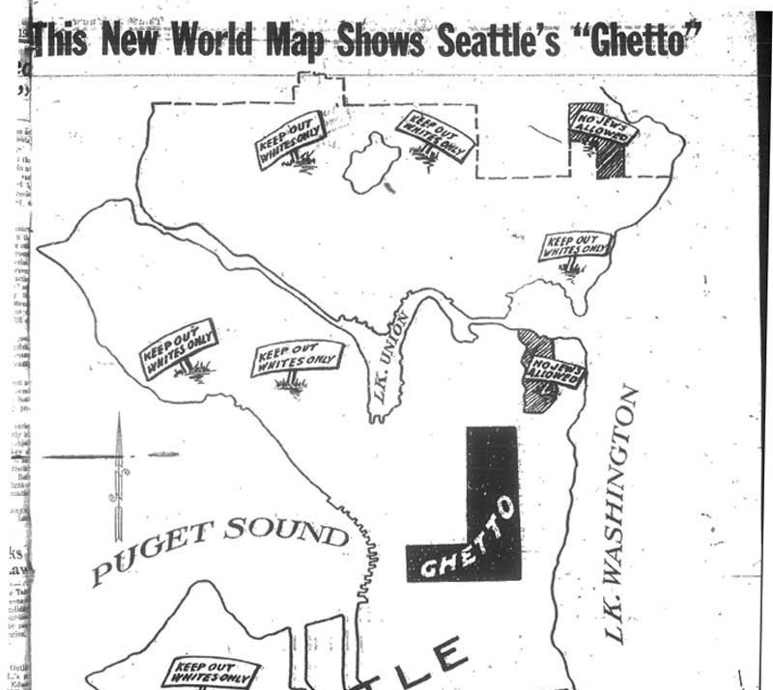
Let’s Talk About Race
Access to safe housing based on credit scores just perpetuates our history of redlining.
Allowing landlords to do credit-checks for potential tenants does not meet the criterium for Seattle’s Race & Social Equity toolkit.
Credit checks are not unbiased and in fact continue our punitive housing practices of the past.

Slide 9
“Credit Reporting and credit scoring are supposed to be entirely objective, with no room for flawed tools such as human judgement (and the biases built into human minds). Yet for the past two decades, study after study has found that African American and Latino communities have lower credit scores as a group than whites (and Asians, when the data is available).”
“Why do all these studies show such racial disparities in credit scores? Is it because communities of color are somehow less responsible? Are there cultural differences No, these are not the explanations. Instead, the explanation lies in the very nature of judging humans based on past behavior. By doing so, credit scores necessarily incorporate elements of past inequality.”
“Past imperfect: how credit scores and other analytics ‘bake in’ and perpetuate past discrimination.” RACIAL JUSTICE AND Equal economic opportunity project- national consumer law center (May, 2016).

Slide 10
Using the past to judge the future denies people the opportunity to achieve better for themselves
“The use of credit reports and scores entrenches and reinforces inequality by dictating a consumer’s access to future opportunities. Credit history is used as a gate keeper for many important necessities- employment, housing (both rental and homeownership), insurance, and of course, affordable credit.”
BIG DATA Reporting:
A newer trend in credit reporting. A consumer’s credit score can be affected by the type of store they shop at. As an example, a consumer may have no history of missed payments, but their purchases show they shop at stores with other consumers who do, like the Dollar Store. Their credit score can go down simply by affiliation. Nowhere do we see that more than in a consumer’s zip code. Lower-income zip codes can automatically receive a lower credit rating.

Slide 11
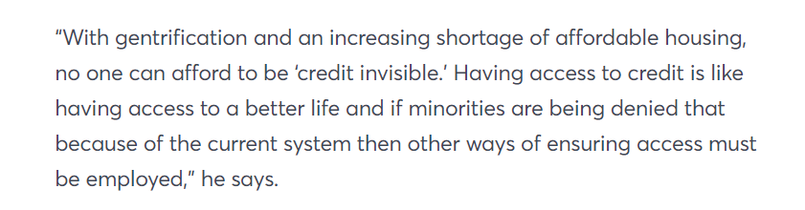
Racial Inequality in lending practices leads to Credit-inequality and credit-invisibility
~Sen. Tim Scott
cnbc.com/2018/05/18/credit-inequality-contributes-to-the-racial-wealth-gap.html
When someone is determined to have no-credit when applying for an apartment, it is the same as having poor-credit. These applications often will be denied automatically. Especially if the apartment complex/management company is using Rental Screening software such as On-Site.
This means that applicants are being denied apartments with no actual proof that they are renter’s who cannot make timely and consistent rental payments.
“What is happening is that ongoing racial inequality has led to credit inequality.
The current credit scoring model ends up eliminating many African-Americans, Latinos, and young people that are otherwise credit worthy, making them in effect “credit invisible.” Credit invisibility leaves a person unable to access necessities, since, besides homeownership, credit is used when a person applies for health insurance, car insurance, and even employment.”

Slide 12
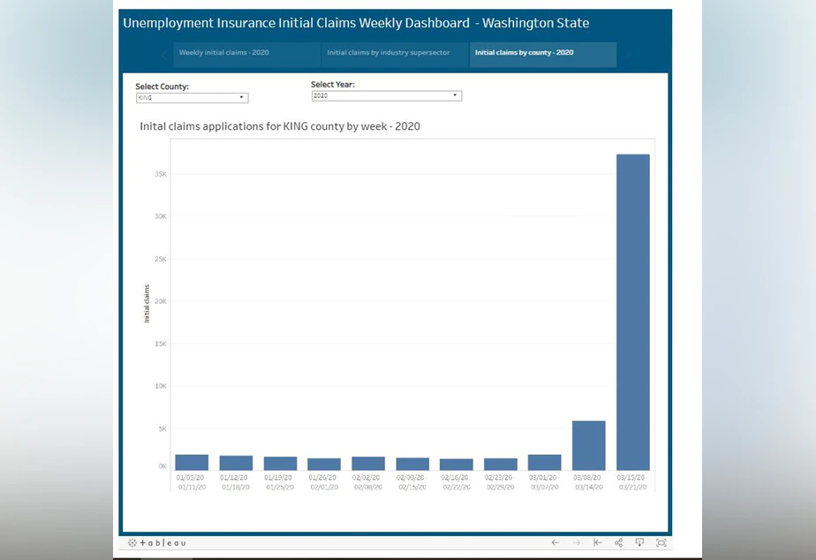
Why is this pertinent now?
The recent outbreak of the Covid-19 pandemic has made even more clear the effects of economic disparity in our city.
The economic windfall of lost jobs across our cities will not be solved by a few month Eviction-pause.

Slide 13
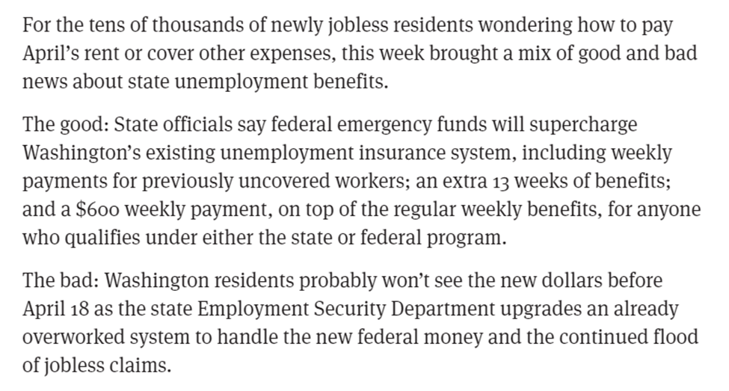
There are limited resources to protect our citizens from irreparable financial ruin
Although there is an Eviction ban currently, that does not save our renter’s from having to save up months of rent.
We have an opportunity to create positive change from this global disaster. It is clear from covid-19 that our society will not return to “normal” overnight. Banning credit-scores for rental applications is one very impactful step we can take to ensure our citizens are not harmed further.
https://www.seattletimes.com/business/economy/state-unemployment-agency-tries-to-ramp-up-as-coronavirus-related-claims-pour-in/

Slide 14
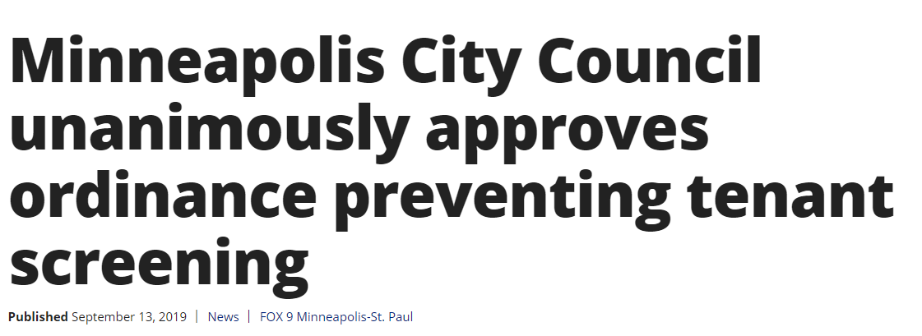
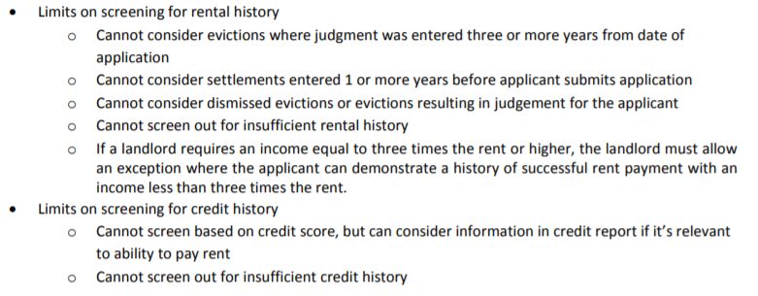
The best part- Minneapolis has already passed similar legislation!

Slide 15
In the past years we have passed some amazing renter protections in the City of Seattle, from Criminal Background to Source of Income. Both of those ordinances do nothing if landlords are allowed to require a 740+ Credit Score.
Let’s not just make feel-good legislation. We were already over our heads with a housing affordability crisis. It is inevitable that Covid-19 will further decimate our communities and increase economic disparity.
Removing credit checks from apartment applications can level the playing fields between the “Haves” and “Have Nots.” This will be legislation that will make a positive impact on a great number of Seattleites and their access to greater housing choices.
Let’s take it one step further and remove credit checks for rental applications!

Slide 16
Resources
https://www.sunmarkfcu.org/connect/sunmark-360/12-worst-data-breaches-last-decade
https://www.cnbc.com/2018/05/18/credit-inequality-contributes-to-the-racial-wealth-gap.html
https://www.startribune.com/small-landlords-fear-limits-on-tenant-screening/560181422/
https://www.seattletimes.com/business/economy/state-unemployment-agency-tries-to-ramp-up-as-coronavirus-related-claims-pour-in/
https://lims.minneapolismn.gov/Download/File/2771/Renter%20Protections%20Ordinance-Sep-13-2019.pdf
https://www.fox9.com/news/minneapolis-city-council-unanimously-approves-ordinance-preventing-tenant-screening

